Slide 1



Todays Pain
Low reliability (best effort)
Expensive (roaming)
Mobile Data
Low reliability (best effort)
Not working in all networks
Expensive (roaming)
2G/3G/4G-Data

Slide 2


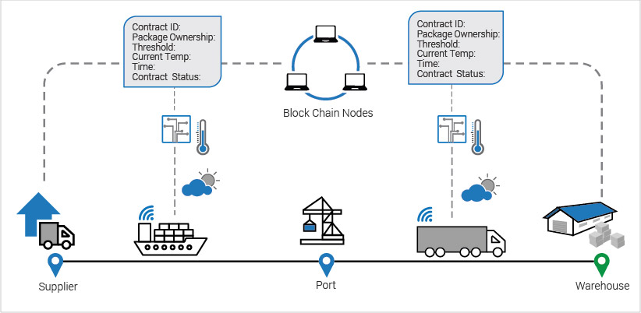
Dataless Sea Container Tracking Service
Predefined automated messages are sent via the current 3G/4G/SatCom global carrier networks without data connection, fast and reliable without any need of roaming data.
Notes:
roaming call in Amsterdam? Angry see the phone bill? Important mobile business call with Skype or Viber? THESE problem I will address in the presentation.

Slide 3
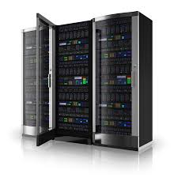
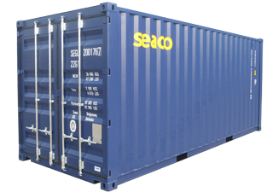




TMS (Travelling Messaging System)
Unique two ways automated messaging service embedded in U-blox HW,with the objective to be the first tracking service in the world to communicate without any DATA or SMS.
OTT-based and suitable for all mobile operators globally and completely without any charge to mobile operators.
TMS Cloud
STEP 1: Call a unique local number and hang-up.
STEP 2: Call back with unique caller ID
and acknowledge and hang-up.
TMS will be embedded in the IoT Tracking HW device

Slide 4
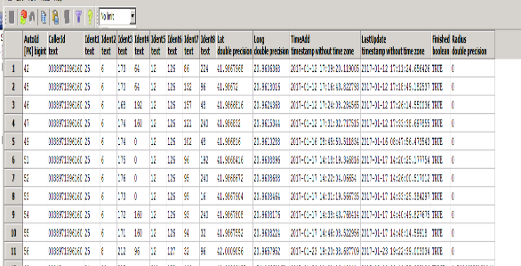

TMS cuts expensive IoT Tracking Messaging Data
Application | ID | Function
Flat Rack Container | 08-50001000 | ETA 13:24
Sea Container | 08-500010001 | Latitude Position
Contract ID | 08-50001088 | Blockchain Status, Order Management
Deviation | 08-50001003 | Tipped container, Shock Vibration
Active Temperature-Controlled Air Cargo Containers | 08-50001004 | Set temperature range +/-0 to +25
IoT Device Power | 08-50001005 | Battery time left

Slide 5

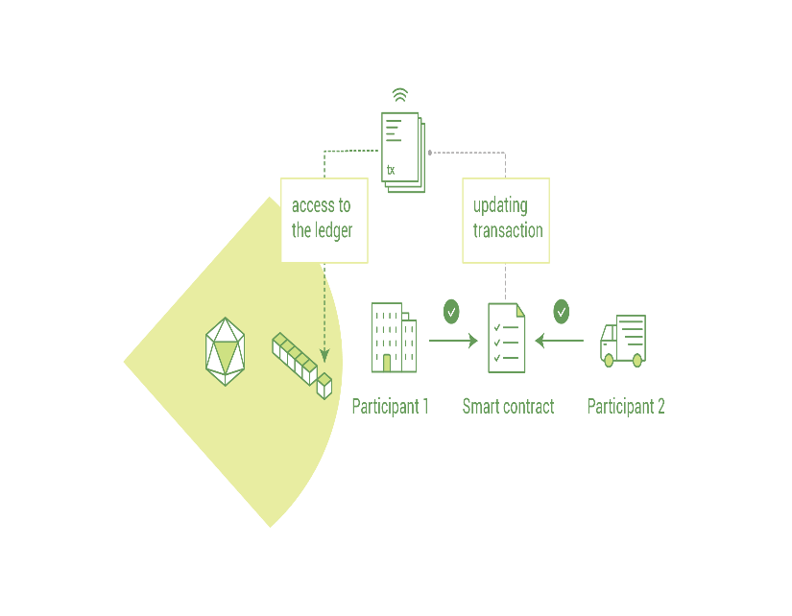
Positioning in the logistic chain
This new way of using tracking messaging with no use of traditional datacom will be fully functional with implementation of a framework of messaging algorithms that will execute predefined commands between the Container- IoT HW-Blockchain Nodes and transmit data in a ringing mode”, i.e“give me information about the temperature status”
Latitude 57.708895 Longitude 11.973479
Step 1: Call the function number "enter the position"? For example 08- 43000001 (when making calls up to this number are the 6th after the forthcoming calls exact position)
Step 2: 3 calls Latitude:
No. 1) 08-43 00 05 77 (last first three in latitude) No 2) 08-43 00 00 88? No 3) 08-43 00 00 95
TMS Cloud
Step 3: 3 calls Longitude:
No. 1) 08-43 00 01 19 (last in first three longitude) No. 2) 08-43 00 07 34? No 3) 08-43 00 00 79
Step 4: TMS cloud calls back and confirms the position obtained and update the transaction to the ledger (i.e 6 calls).

Slide 6
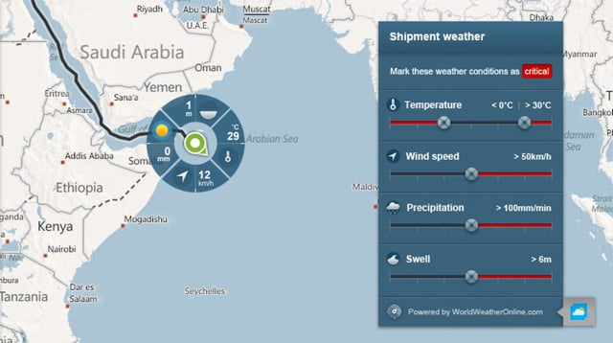
TMS functionality from the position of the sea cargo container
TMS Cloud calls a predefined message
08-50000072 temperature increase alert and hang-up
2) InnoTel TMS cloud service now
know that cargo container X has a temperature exeeding 0,XX degrees
TMS Cloud

Slide 7
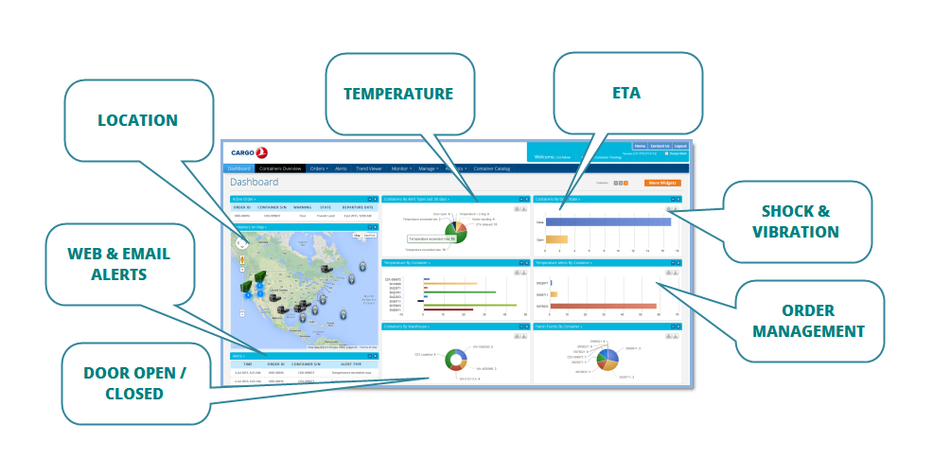
TMS functionality to the cargo container
Calling with CallerID 08-50000010 = Asking for Temperature?
TMS Cloud
2) Calling number 08-5000050 = Acknowledge Temperature of -2,94304 dgr

